Slide 1
Group 4 | Project 3 JDBC

Slide 2
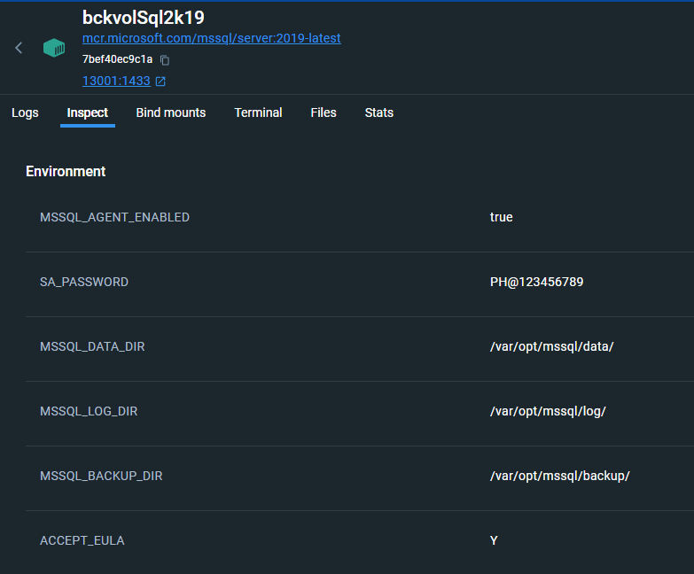
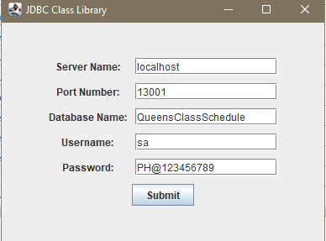
Connect To LocalHost

Slide 3
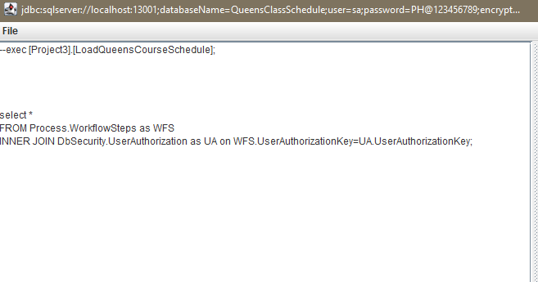

Slide 4
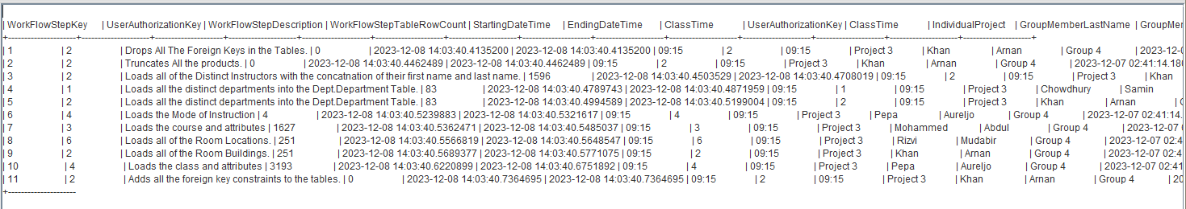
WorkflowSteps

Slide 5
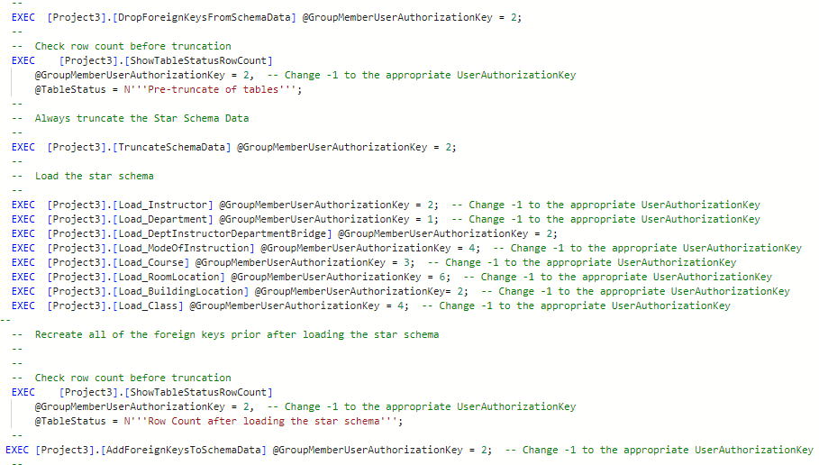
LoadSchema Stored Procedure

Slide 6
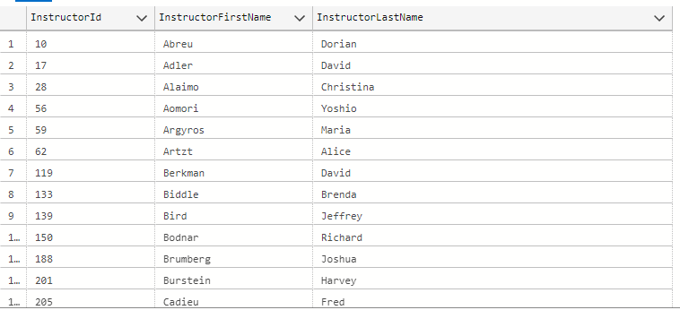
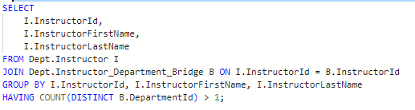
Query 1: Show all instructors who are teaching in classes in multiple departments

Slide 7
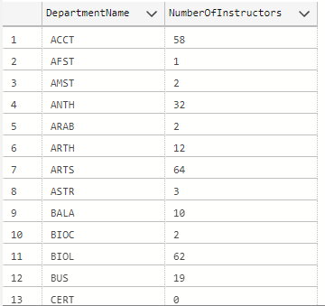
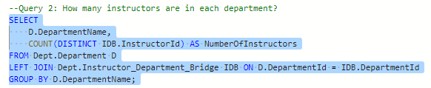
Query 2: How many instructors are in each department

Slide 8
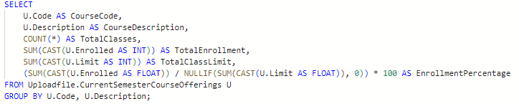
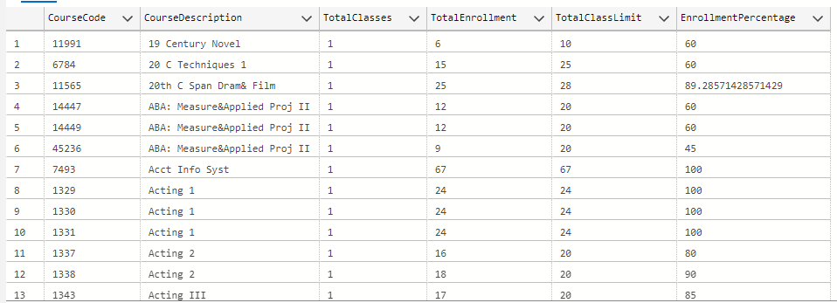
Query 3: How many classes are being taught this semester with groupings of percentage.

Slide 9
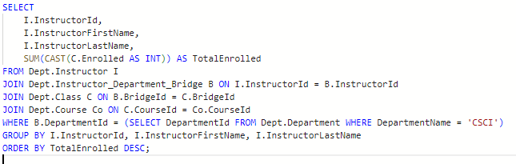
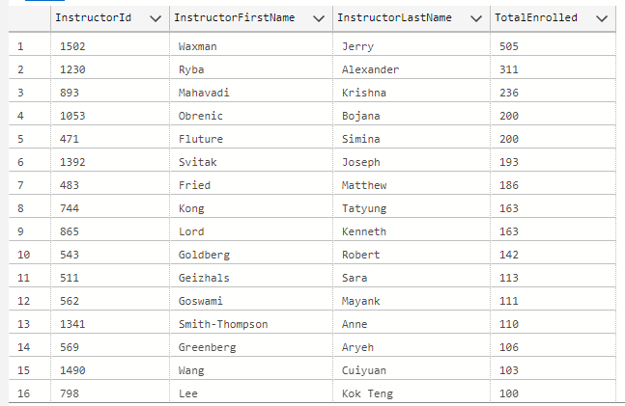
Rank all the professors who teach in the 'CSCI' department for total enrolled

Slide 10
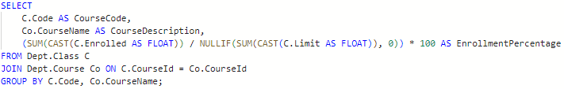
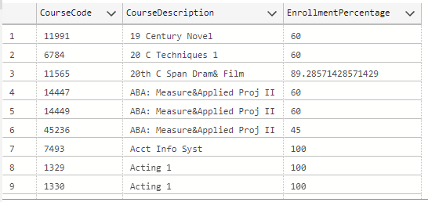
Retrieve all courses and their enrollment percentages for the current semester.

Slide 11
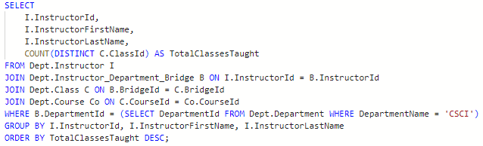
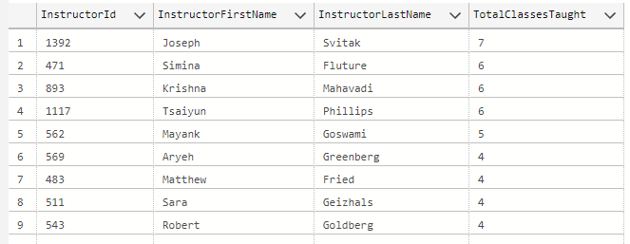
Find the total number of classes taught by each instructor in the CSCI department.

Slide 12
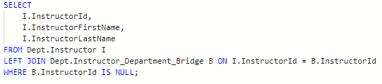
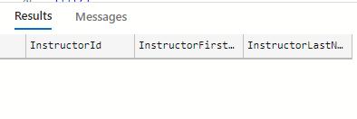
Identify instructors who are not assigned to any department. (Should be null)

Slide 13
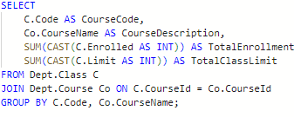
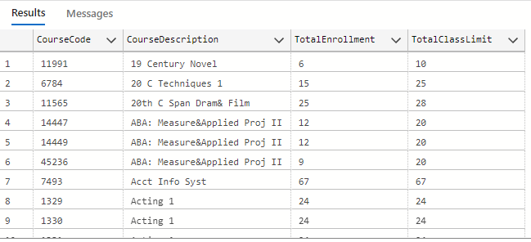
List all courses along with the total enrollment and class limit for the current semester.

Slide 14
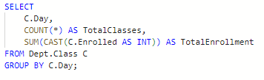
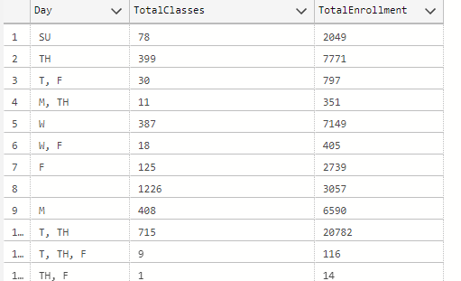
Retrieve the total number of classes and total enrollment for each day section of the week.

Slide 15
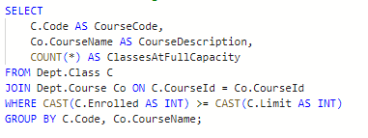
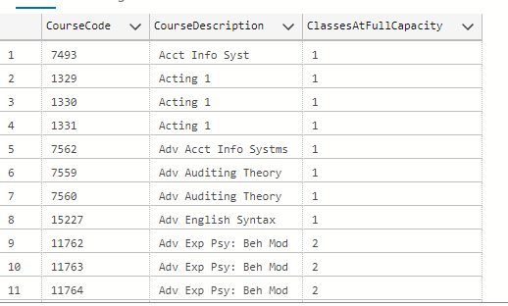
List all courses along with the number of classes that have reached full capacity.

Slide 16
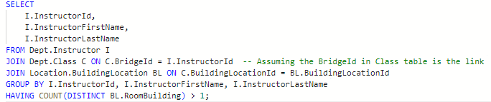
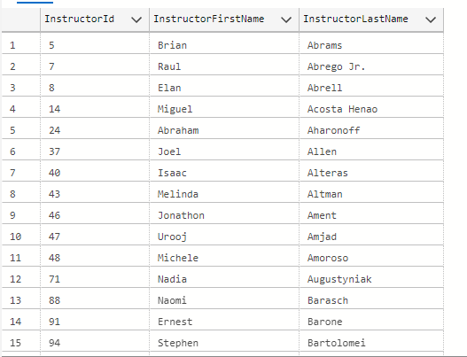
Find the instructors who are teaching classes in multiple buildings.

Slide 17
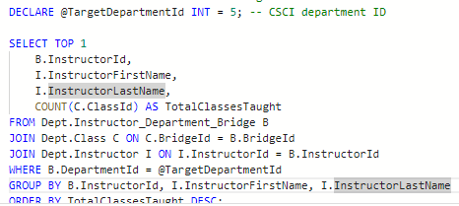

Find the instructors who are teaching the most classes in the CSCI department.

Slide 18
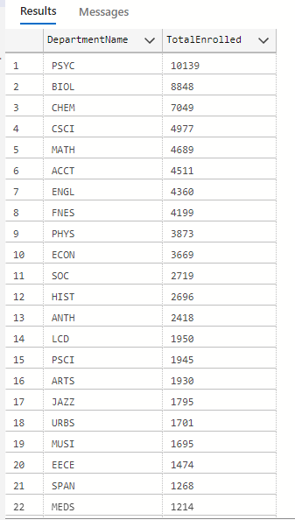
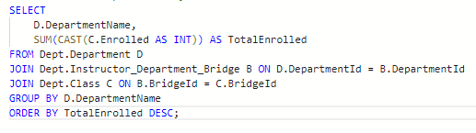
Rank all the departments by the total enrolled.

